Slide 1
EDA HEART DISEASE
File created on: 12-Jun-20 17:05:19

Slide 2
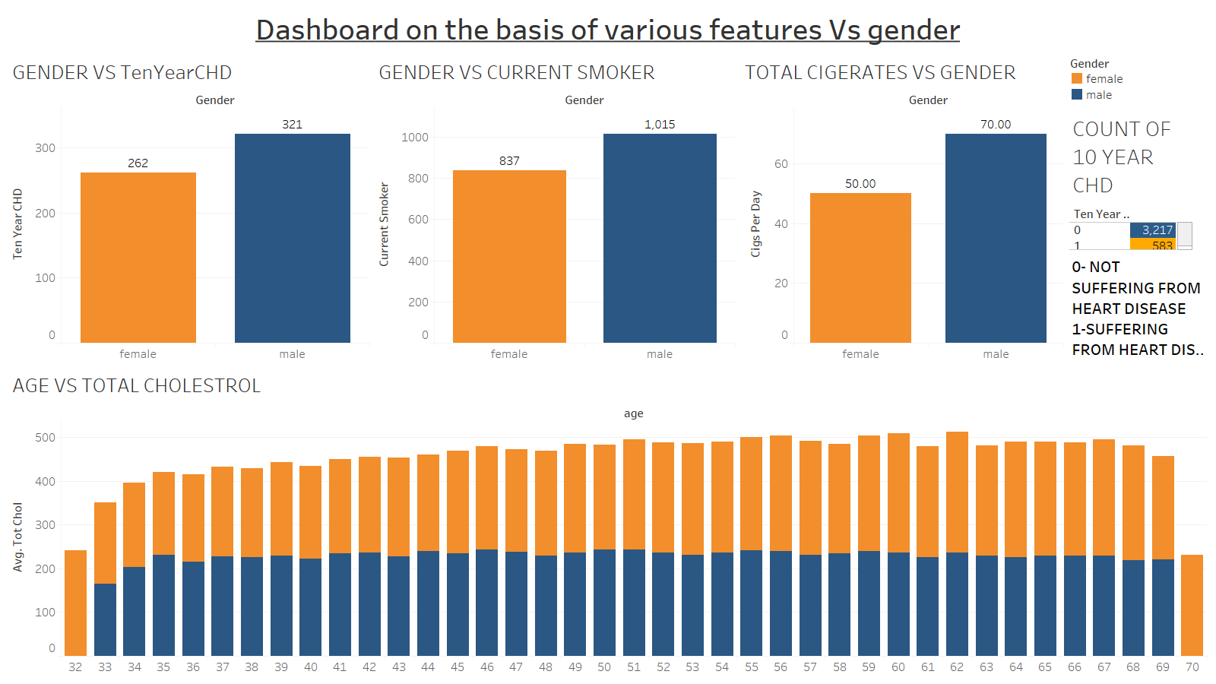

Slide 3
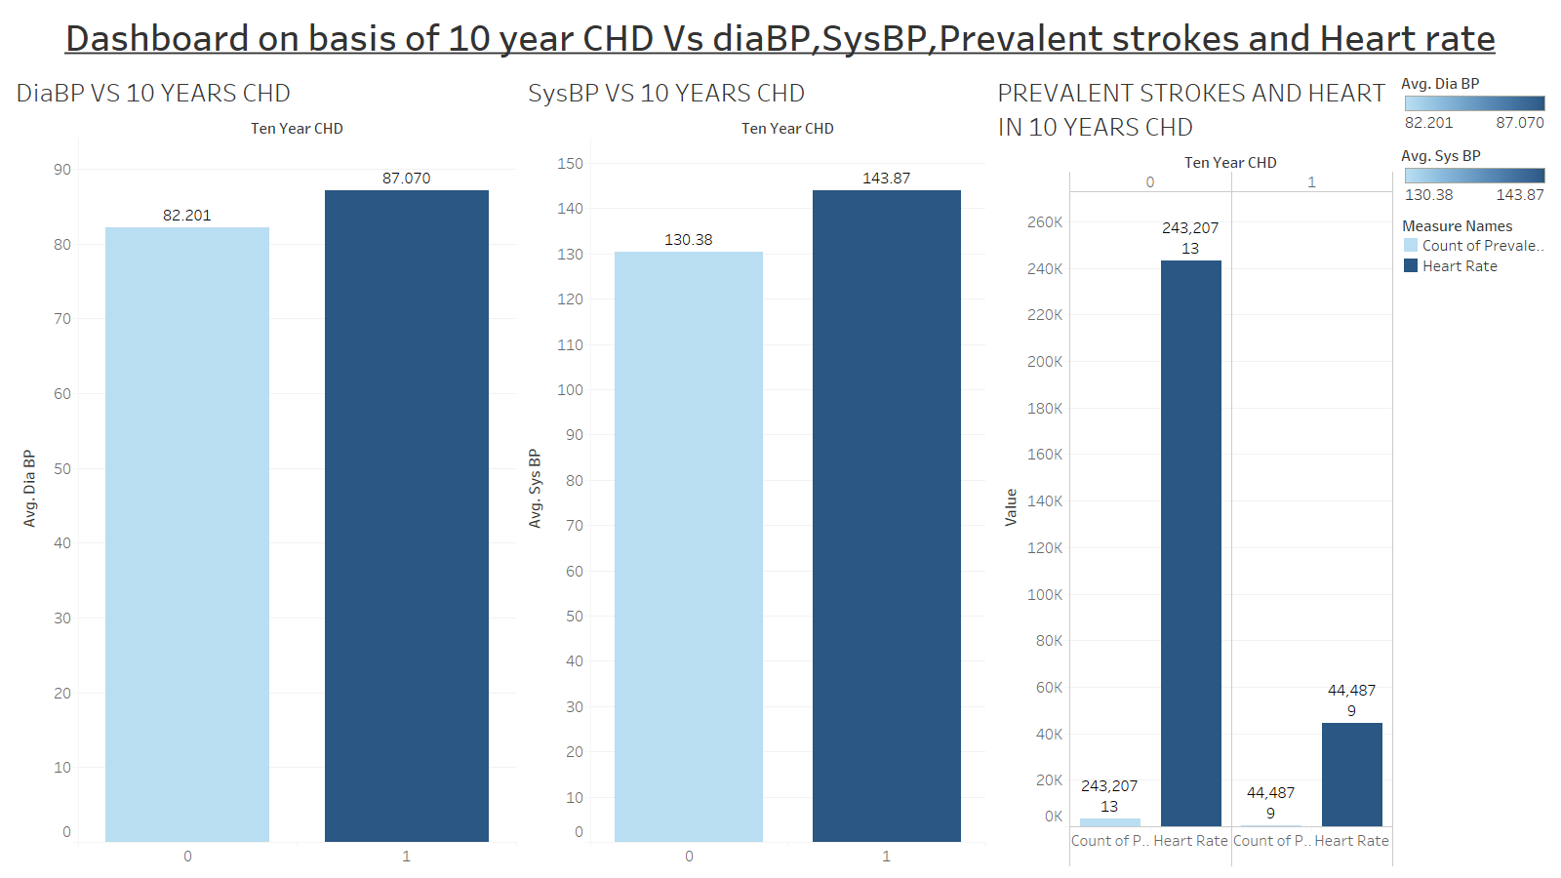

Slide 4
